Slide 1
Unit-3: Queue
Compiled BY:
Ghanashyam BK

Slide 2
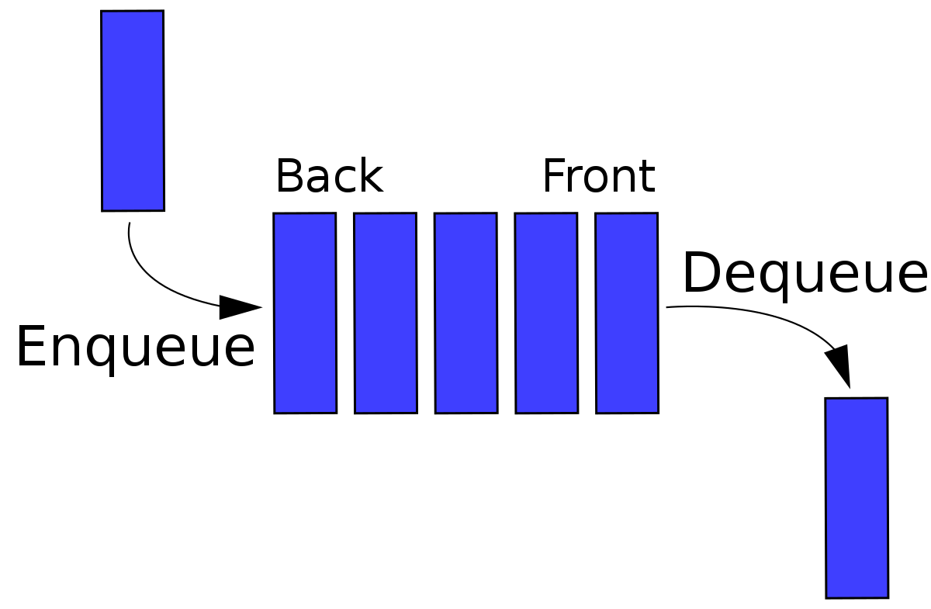
Queue
A Queue is a linear structure which follows a particular order in which the operations are performed.
The order is First In First Out (FIFO).
A good example of a queue is any queue of consumers for a resource where the consumer that came first is served first.
The difference between stacks and queues is in removing.
In a stack we remove the item the most recently added; in a queue, we remove the item the least recently added.

Slide 3
Applications of queue
Serving requests on a single shared resource, like a printer, CPU task scheduling etc.
In real life, Call Center phone systems will use Queues, to hold people calling them in an order, until a service representative is free.
Handling of interrupts in real-time systems. The interrupts are handled in the same order as they arrive, First come first served.
To assign CPU to multiple processes by the Operating System.

Slide 4
Queue as an ADT
MakeEmpty(q): To make q as an empty queue
IsEmpty(q): To check whether the queue q is empty. Return true if q is empty, return false otherwise.
IsFull(q): To check whether the queue q is full. Return true in q is full, return false otherwise.
Enqueue(q, x): To insert an item x at the rear of the queue, if and only if q is not full.
Dequeue(q): To delete an item from the front of the queue q if and only if q is not empty.
Traverse (q): To read entire queue that is display the content of the queue.

Slide 5
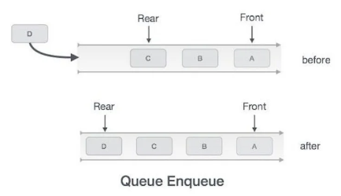
Enqueue Operation
Queue maintains two data pointers, front and rear
The following steps should be taken to enqueue(insert) data into queue –
Step 1 – Check if queue is full
Step 2 – if queue is full
produce overflow error and exit
Else
increment rear pointer to point next empty space and add data element to the queue location, where rear is pointing
Step 3 - return success

Slide 6
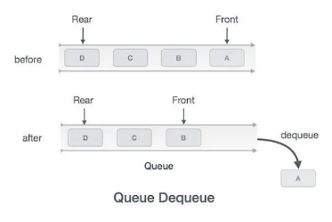
Dequeue Operation
Accessing data from queue is a process of two steps
Access the data from where front is pointing
And remove the data after access
The following steps are taken to perform dequeue operation
Step 1 – Check if queue is empty
Step 2 – if queue is empty
produce underflow error and exit
else
access data where front is pointing, increment front pointer to point next available data element
Step 3 – return success.

Slide 7
Linear Queue
A Linear Queue is generally referred to as Queue.
It is a linear data structure that follows the FIFO (First In First Out) order.
A real-life example of a queue is any queue of customers waiting to buy a product from a shop where the customer that came first is served first.

Slide 8
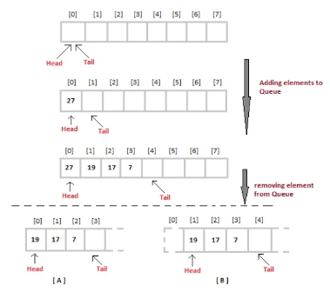
Linear Queue

Slide 9
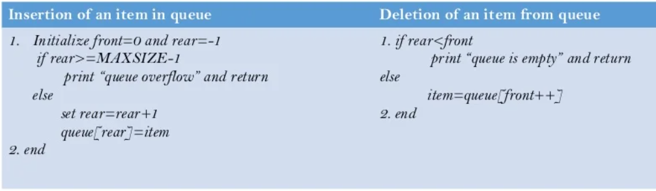
Linear Queue

Slide 10
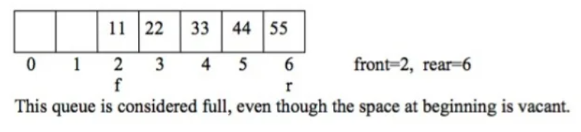
Problems with Linear queue implementation
Both rear and front indices are increased but never decreased.
As items are removed from the queue, the storage space at the beginning of the array is discarded and never used again.
Wastage of the space is the main problem with linear queue which is illustrated by the following example.

Slide 11
Implementation of Linear Queue
Initializtion
#include <stdio.h>
#define SIZE 5
void enQueue(int);
void deQueue();
void display();
int items[SIZE];
int front = -1;
int rear = -1;
EnQueue Operation
void enQueue(int value) {
if (rear == SIZE - 1)
printf("\nQueue is Full!!");
else {
if (front == -1)
front = 0;
rear++;
items[rear] = value;
printf("\nInserted -> %d", value);
}
}
DeQueue Operation
void deQueue() {
if (front == -1)
printf("\nQueue is Empty!!");
else {
printf("\nDeleted : %d", items[front]);
front++;
if (front > rear)
front = rear = -1;
}
}

Slide 12
Implementation of Linear Queue
Print Data in Queue
void display() {
if (rear == -1)
printf("\nQueue is Empty!!!");
else {
int i;
printf("\nQueue elements are:\n");
for (i = front; i <= rear; i++)
printf("%d ", items[i]);
}
printf("\n");
}
Main function
int main() {
deQueue(); //deQueue is not possible on empty queue
enQueue(10);
enQueue(23);
enQueue(35);
display();
//deQueue removes element entered first i.e. 1
deQueue();
display();
return 0;
}

Slide 13
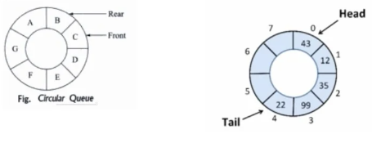
Circular Queue
A queue where the start and end of the queue are joined together.
A circular queue is one in which the insertion of a new element is done at very first location of the queue if the last location of the queue is full.

Slide 14
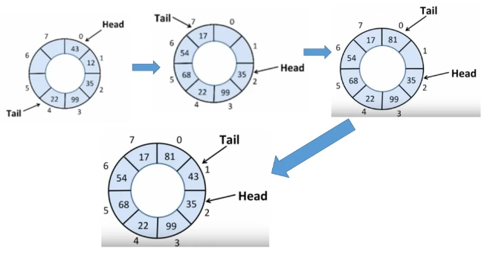
Circular Queue

Slide 15
Circular Queue
The circular queue work as follows:
two pointers FRONT and REAR
FRONT track the first element of the queue
REAR track the last elements of the queue
initially, set value of FRONT and REAR to -1

Slide 16
Circular Queue
Enqueue Operation
check if the queue is full
for the first element, set value of FRONT to 0
circularly increase the REAR index by 1 (i.e. if the rear reaches the end, next it would be at the start of the queue)
add the new element in the position pointed to by REAR
Dequeue Operation
check if the queue is empty
return the value pointed by FRONT
circularly increase the FRONT index by 1
for the last element, reset the values of FRONT and REAR to -1

Slide 17
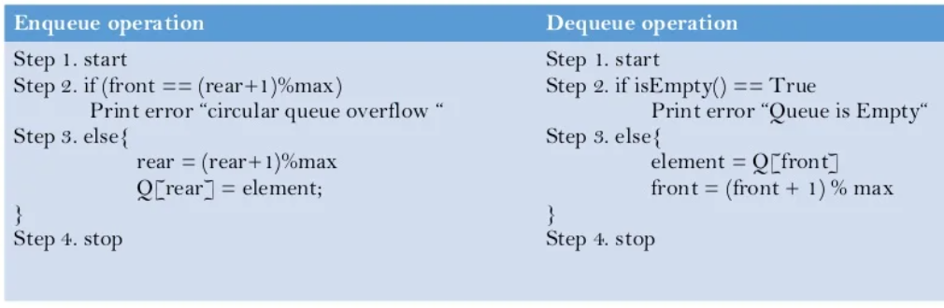
Circular Queue

Slide 18
Implementation of Circular Queue
Initialization
#include <stdio.h>
#define SIZE 5
int items[SIZE];
int front = -1;
int rear = -1;
Checf if queue is full
int isFull() {
if ((front == rear + 1) || (front == 0 && rear == SIZE - 1)) {
return 1;
}
else{
return 0;
}
}
Checf if queue is Empty
int isEmpty() {
if (front == -1){
return 1;
}
else {
return 0;
}
}

Slide 19
Implementation of Circular Queue
Adding Element(Enqueue)
void enQueue(int element) {
if (isFull())
printf("\n Queue is full!! \n");
else {
if (front == -1) front = 0;
rear = (rear + 1) % SIZE;
items[rear] = element;
printf("\n Inserted -> %d", element);
}
}
Removing Element(Dequeue)
int deQueue() {
int element;
if (isEmpty()) {
printf("\n Queue is empty !! \n");
return (-1);
} else {
element = items[front];
if (front == rear) {
front = -1;
rear = -1;
}
Removing Element(Dequeue)Contd…
// Q has only one element, so we reset the
// queue after dequeing it. ?
else {
front = (front + 1) % SIZE;
}
printf("\n Deleted element -> %d \n", element);
return (element);
}
}

Slide 20
Implementation of Circular Queue
Print the Queue
void display() {
int i;
if (isEmpty())
printf(" \n Empty Queue\n");
else {
printf("\n Front -> %d ", front);
printf("\n Items -> ");
for (i = front; i != rear; i = (i + 1) % SIZE) {
printf("%d ", items[i]);
}
printf("%d ", items[i]);
printf("\n Rear -> %d \n", rear);
}
}
Main Function
int main() {
// Fails because front = -1
deQueue();
enQueue(1);
enQueue(2);
enQueue(3);
enQueue(4);
enQueue(5);
// Fails to enqueue because front == 0 && rear == SIZE – 1
enQueue(6);
Main Function(Contd…)
display();
deQueue();
display();
enQueue(7);
display();
// Fails to enqueue because front == rear + 1
enQueue(8);
return 0;
}

Slide 21
Linear Queue vs Circular Queue
Linear Queue | Circular Queue
Arranges the data in a linear pattern. | Arranges the data in a circular order where the rear end is connected with the front end.
The insertion and deletion operations are fixed i.e, done at the rear and front end respectively. | Insertion and deletion are not fixed and it can be done in any position.
It is inefficient in comparison to a circular queue. | It is more efficient in comparison to linear queue.
In the case of a linear queue, the element added in the first position is going to be deleted in the first position. The order of operations performed on any element is fixed i.e, FIFO. | In the case of circular queue, the order of operations performed on an element may change.
Application- People standing for the bus. Cars lined on a bridge. | Application- Computer-controlled traffic signal In CPU scheduling and memory management.

Slide 22
Priority Queue
A priority queue is a special type of queue in which each element is associated with a priority value.
And, elements are served on the basis of their priority. That is, higher priority elements are served first.
However, if elements with the same priority occur, they are served according to their order in the queue.
In a normal queue, the first-in-first-out rule is implemented whereas, in a priority queue, the values are removed on the basis of priority. The element with the highest priority is removed first.

Slide 23
Operations in Priority Queue
Basic operations of a priority queue are inserting, removing, and peeking elements.
Inserting an Element into the Priority Queue
Deleting an Element from the Priority Queue
Peeking from the Priority Queue (Find max/min)

Slide 24
Application of Priority Queue
Dijkstra's shortest path algorithm
for implementing stack
for load balancing and interrupt handling in an operating system
for data compression in Huffman code
In traffic light, depending upon the traffic, the colors will be given priority.

Slide 25
Assignment
Define Queue. Explain its different types.
How does circular queue overcome the limitation of linear queue. Explain.
Write an algorithm and C function to insert an item in Linear queue and Circular queue.
Write an algorithm and C function to delete an item in Linear queue and Circular queue.
Compare stack with queue.
Explain queue as an Abstract Data Type.

